Slide 1
Python Project for Data Science

Slide 2
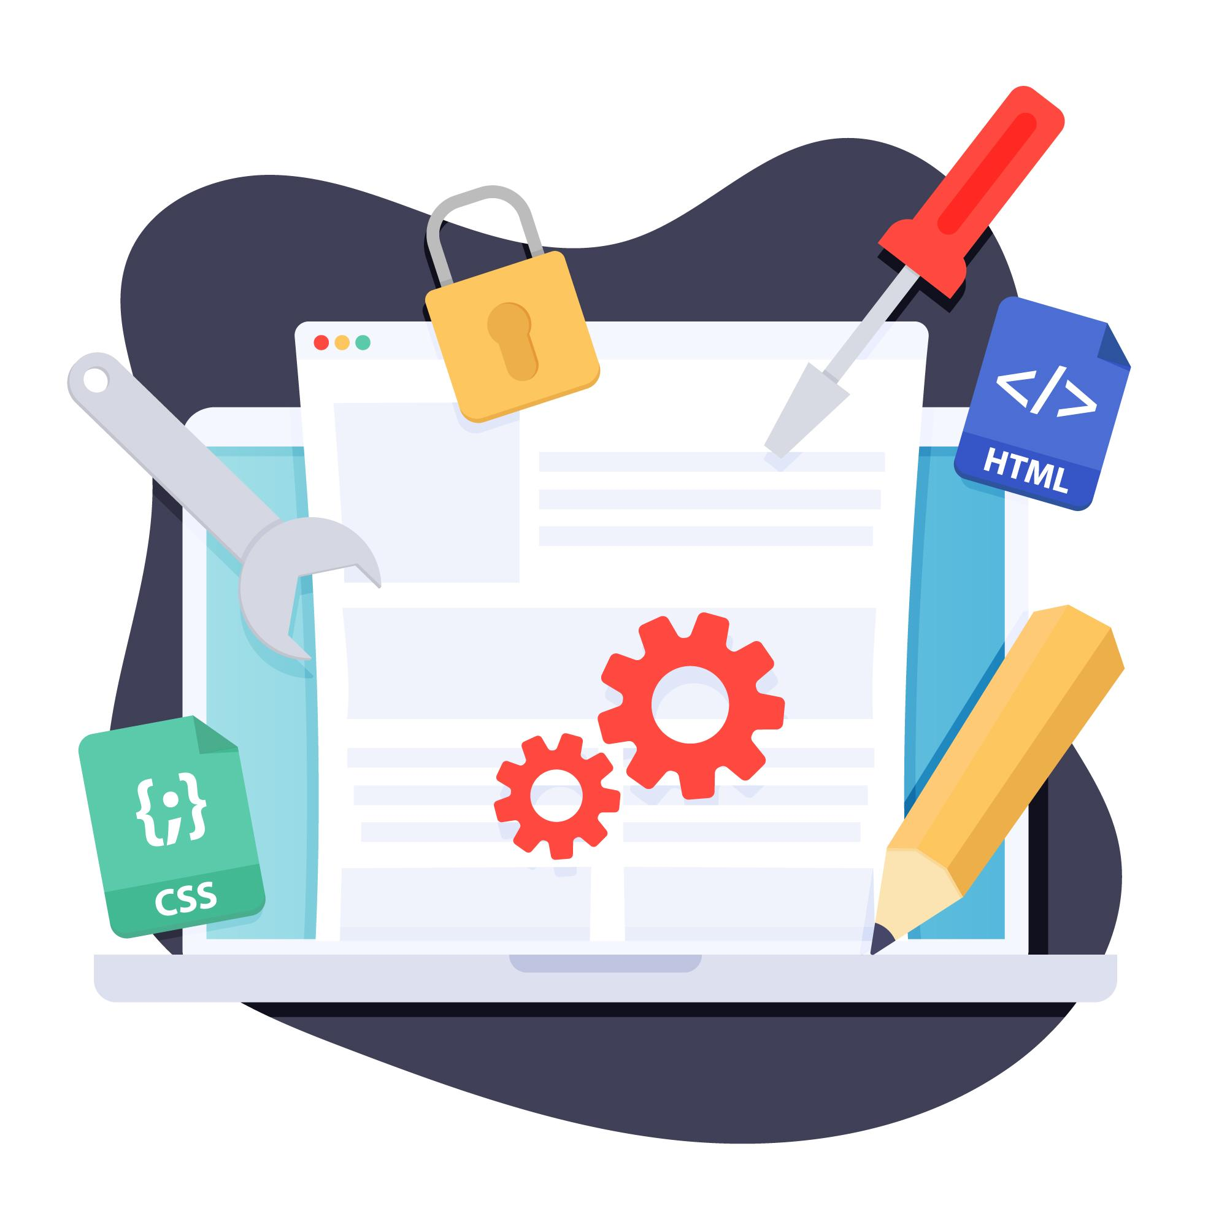
Web Scraping

Slide 3
Course Overview
You will perform specific data science and data analytics tasks such as extracting data, web scraping, visualizing data and creating a dashboard. This project will showcase your proficiency with Python and using libraries such as Pandas and Beautiful Soup within a Jupyter Notebook. Upon completion you will have an impressive project to add to your job portfolio.

Slide 4
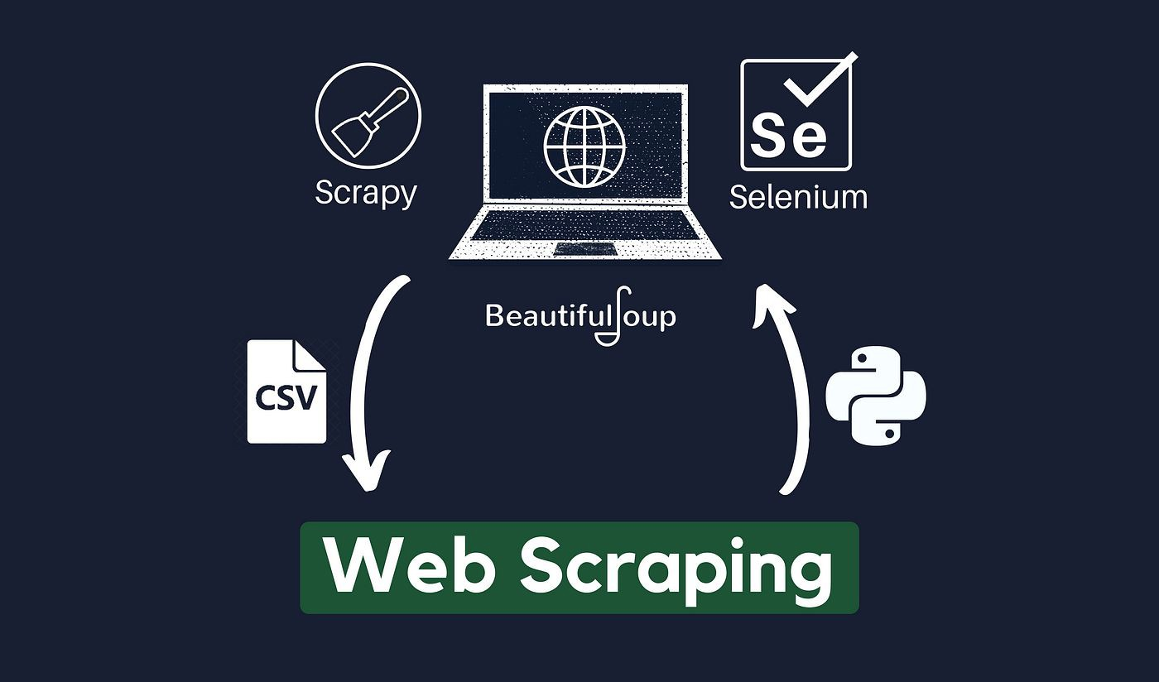
Session Content
What is Web Scraping?
How do we do?
Tools to use
Ethics for scraping
Demo

Slide 5
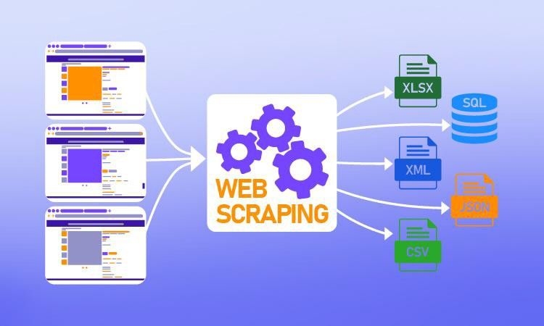
What is Web Scraping?
Web scraping: is technique for gathering data or information on web pages.
Web scraping: is method to extract data from a website that does not have an API, or we want to extract LOT of data which we can not do through an API due to rate limiting.
Through web scraping we can extract any data which we can see while browsing the web.
You could revisit your favorite website every time it updates for new information, Or you could write a web scraper to have it

Slide 6
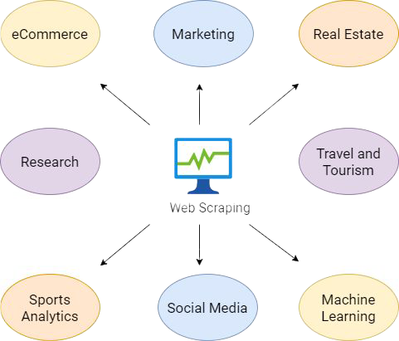
Web Scraping in Real Life
Extract products information
Extract job posting and internships
Extract offers and discount from deal of the day website
Extract date to make search engine
Gathering weather data
Etc.

Slide 7
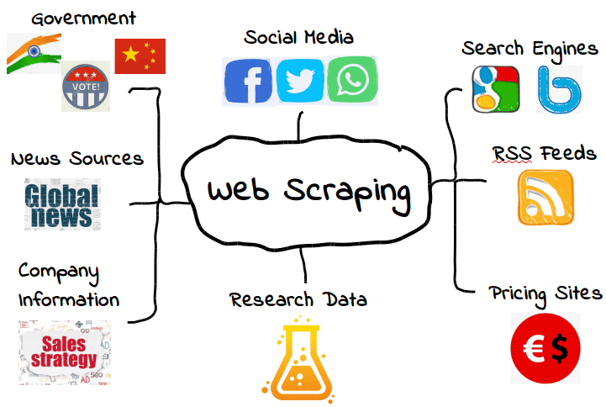

Slide 8
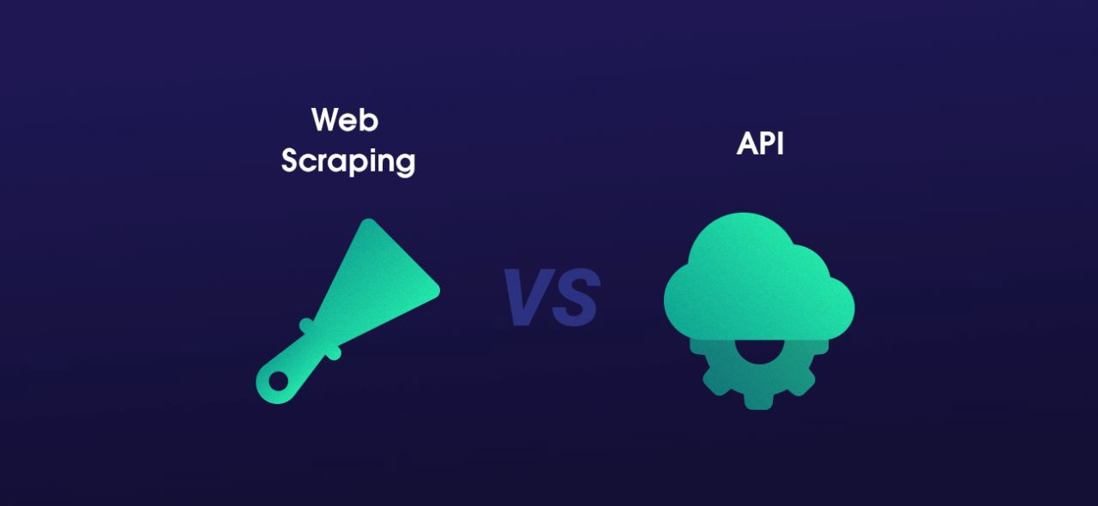
Advanced Web Scraping Vs. API
Web scraping is not rate limited
Anonymously access the website and gather data
Some website don’t have API
Some data is not accessible through an API

Slide 9
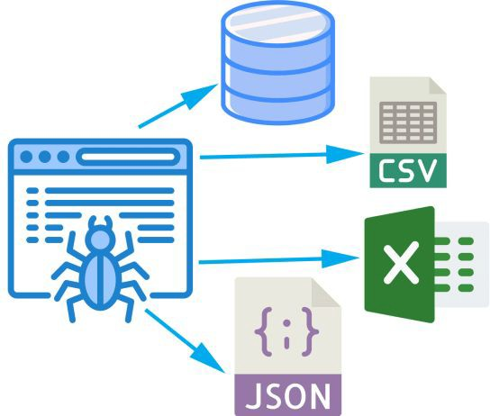
Workflow
Web scraping follows this workﬂow:
Get the website – using HTTP library (request)
Parse the html document – using any parsing library
Beautiful soup
Selenium
scrapy
Store the results – either a db , csv, txt ﬁle etc.

Slide 10
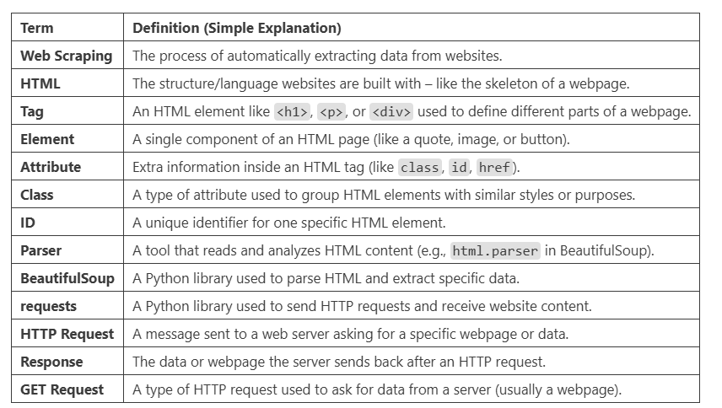

Slide 11
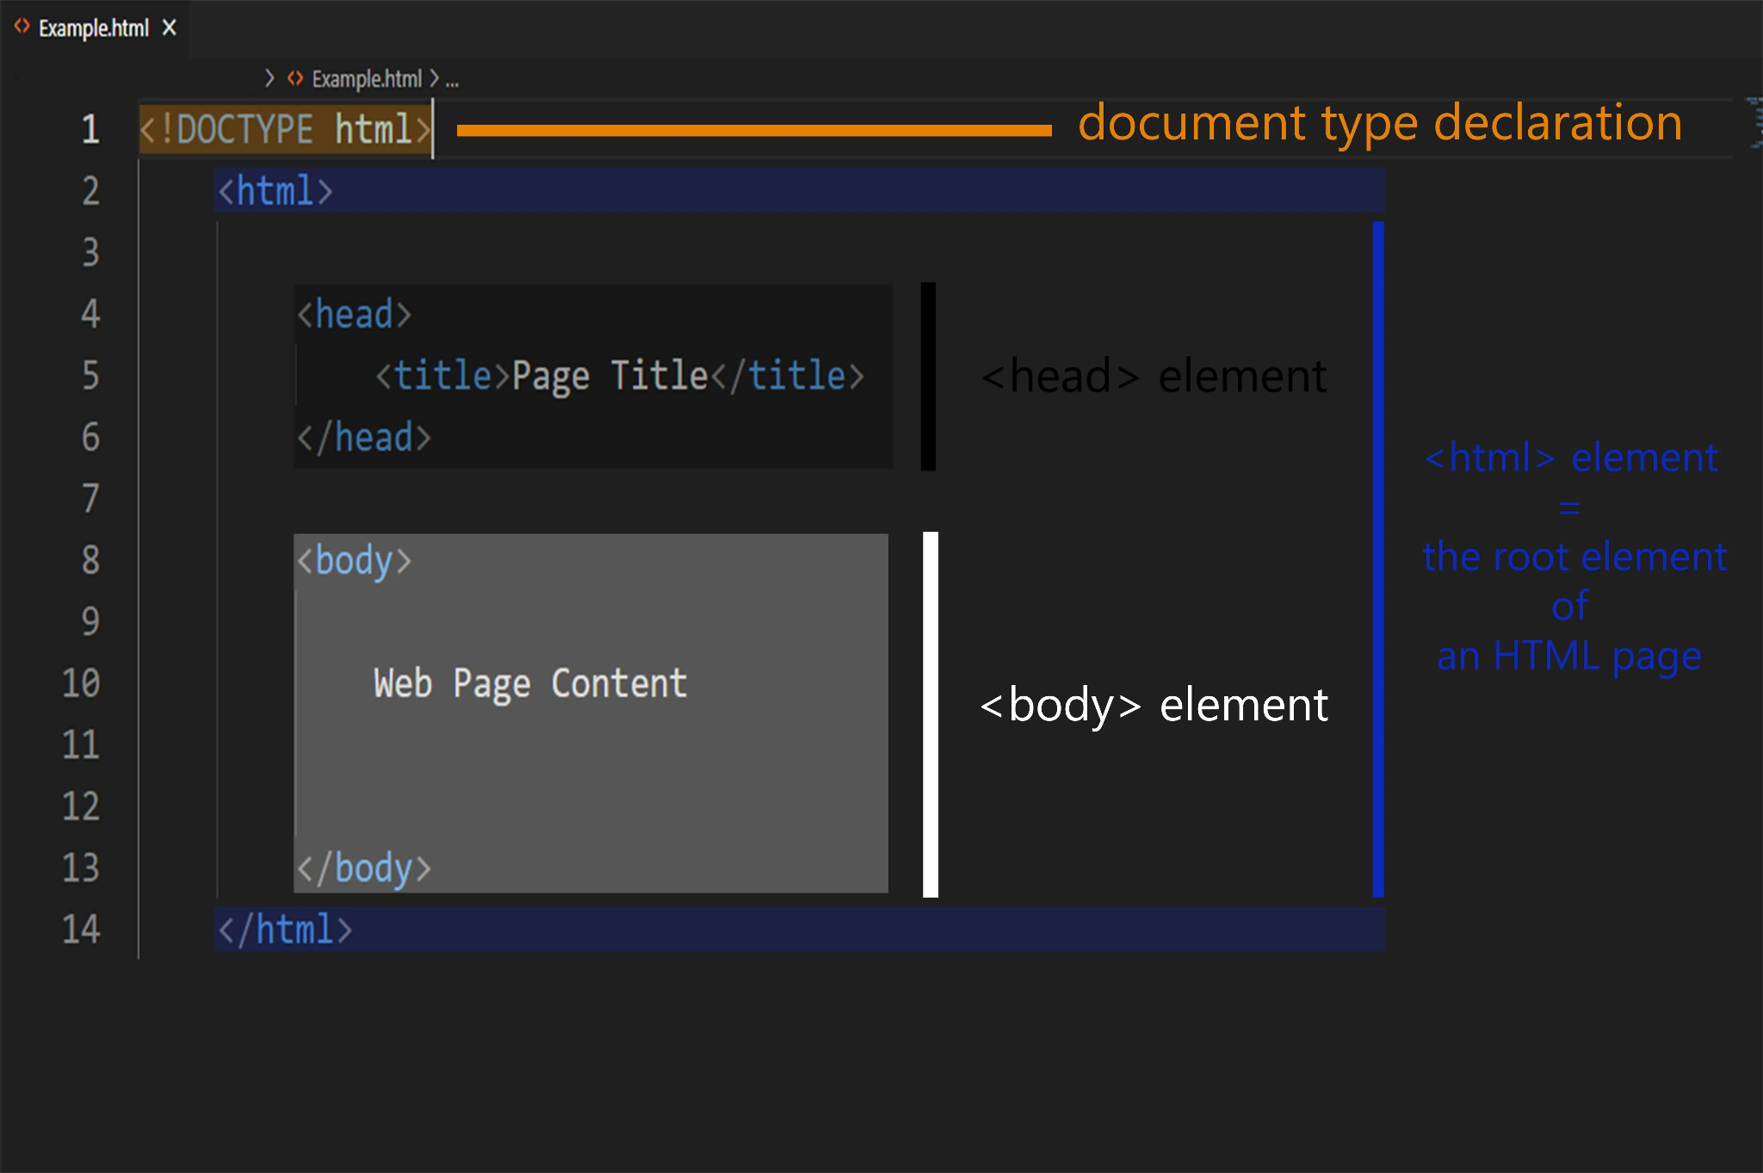

Slide 12
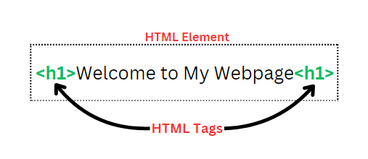
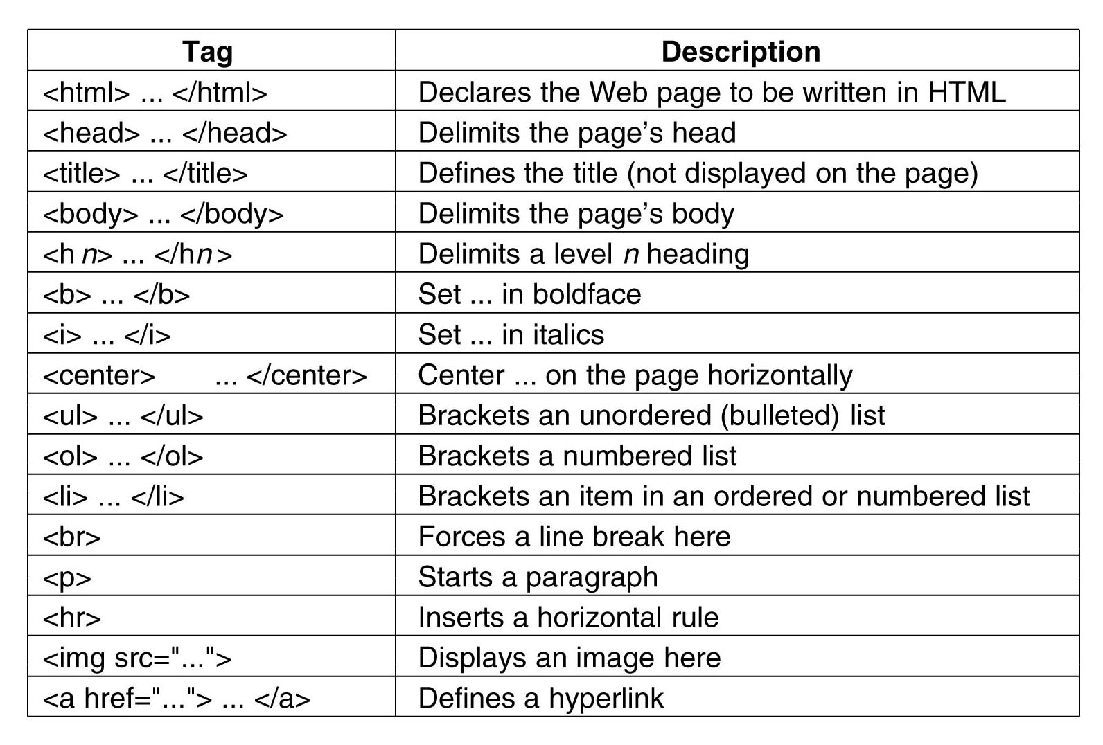
/
Html Tags

Slide 13
⚠️ Mandatory ⚠️
📚 You must watch and study the following resources if you don’t know Html before.
1. Learn HTML In One Video (Complete introduction to HTML in a simple and practical way)
2. HTML Tags Reference
(Understand the most important HTML tags and their usage)

Slide 14
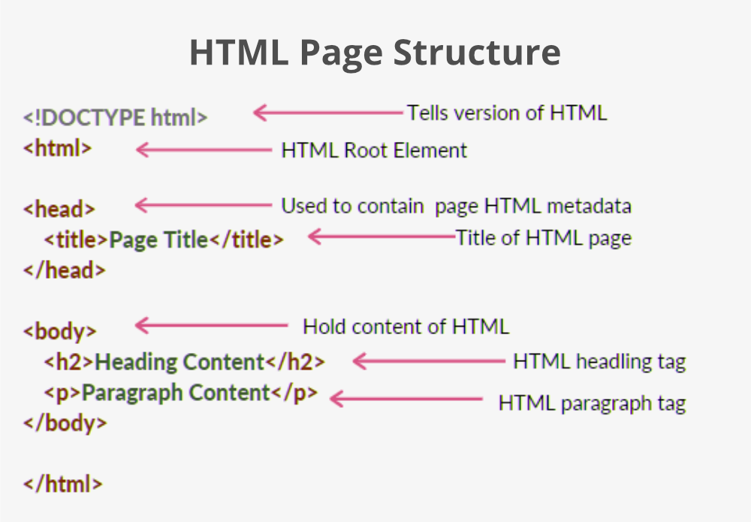
https://jekso.github.io/scrapping-example/index.html

Slide 15
Libraries
BeautifulSoup (bs4)
Selenium
scrapy Framework
Pandas and requests

Slide 16
Feature | BeautifulSoup | Selenium | Scrapy
Type | HTML parser library | Browser automation tool | Full-featured web scraping framework
Best For | Simple static websites | Interactive or JavaScript-heavy websites | Large-scale scraping projects and crawlers
JavaScript Support | No | Yes | No (requires extra tools like Splash)
Speed | Fast | Slower (due to real browser rendering) | Very fast and optimized for crawling
Ease of Use | Easy and beginner-friendly | Relatively easy, but setup required | Steeper learning curve
Installation | Lightweight (only needs BeautifulSoup + Requests) | Requires browser drivers (e.g., ChromeDriver) | Requires full Scrapy setup
DOM Interaction (Click, Scroll) | Not supported | Fully supported | Not supported
Built-in Crawling Features | No (manual handling required) | No | Yes (spiders, pagination, URL rules)
Data Export Options | Manual (e.g., CSV, JSON using pandas) | Manual | Built-in support for JSON, CSV, XML
Suitable For | Small tasks, quick scripts | Medium-scale, interactive scraping | Enterprise-level scraping, large-scale crawling

Slide 17
Is Web Scraping Legal?
In short, the action of web scraping is not illegal. However, some rules need to be followed. Web scraping is illegal when non-publicly available data is extracted.
https://github.com/KOrfanakis/Web_Scraping_With_Python

Slide 18
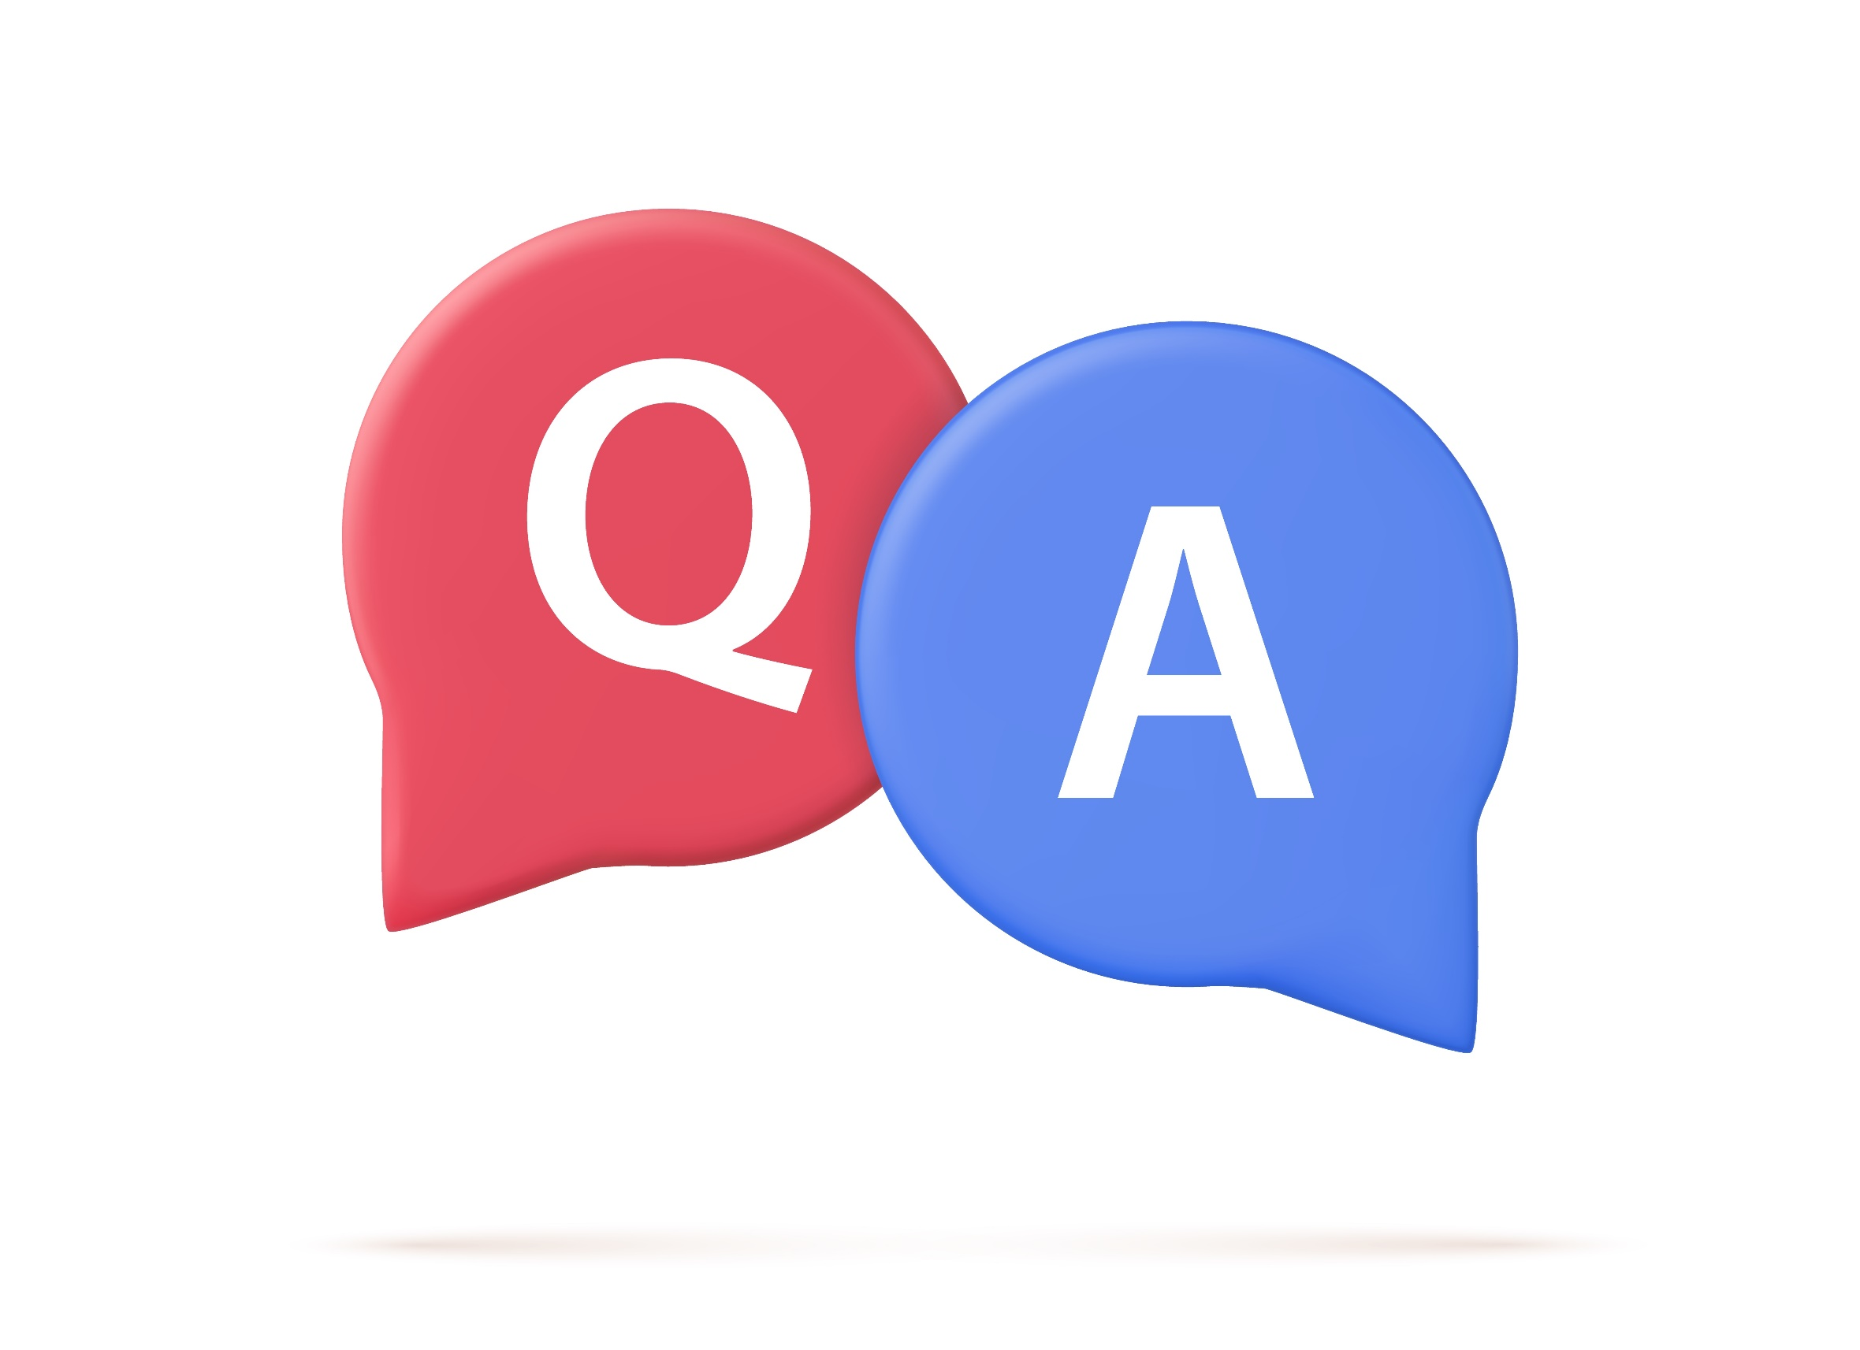
Questions & Answers
34

